Slide 1
Advanced Programming
Unit 1: Programming Paradigms

Slide 2
Structure
schedule per week:
2 hours lecture, 1 hour tutorial
2 hours lab (FT only)
assessment:
Exam (2 hours): 50%
Coursework: 50%
material:
Mainly produced by Jim Paterson
Modified & reorganized by Martin Gallacher

Slide 3
Outcomes
Explain the nature and applicability of a range of programming paradigms, including object oriented, functional, procedural, declarative, and the support provided for each in currently popular programming languages
Explain the nature and applicability of a range of programming language types with respect to whether they are compiled/dynamic, managed/unmanaged, concurrent, domain specific
Evaluate emerging trends in advanced programming languages and techniques
Develop and test a software application by selecting a programming language appropriate to the requirements and making appropriate use of a range of advanced programming techniques available within that language

Slide 4
Introduction
The module involves reflecting on different approaches to thinking about a problem solution
Traditionally, an imperative approach has been popular as it reflects the underlying Von Neumann architecture of the majority of processors
We will contrast this approach with a functional approach by examining the theories of computation of Alan Turing and Alonso Church

Slide 5
Programming Paradigm
The programming model, or paradigm, determines how the (human) programmer expresses ideas to the computer in order to get the computer to do useful computation
Programming creates a solution to a specified problem within a specific problem domain
Different programming models are suited to different kinds of computation that may be required to create a solution or to different problem domains
Or, may be suited to the way in which the programmer formulates their ideas
Can be very difficult for programmers who have learned one model well to adapt to another model
Models are not always mutually exclusive or opposite to each other, many languages are hybrids to some extent and support aspects of more than one programming model

Slide 6
Summary of programming models
Programming model*
Imperative
Declarative
Procedural
Object Oriented
Logic
DSL
Functional
*Note this is by no means an exhaustive listing of programming models!

Slide 7
Imperative Approach
An imperative language uses a sequence of statements to determine how to reach a certain goal
These statements are said to change the state of the program as each one is executed in turn
Focus is on how to perform tasks (algorithms) and how to track changes in state
Algorithms are expressed with statements and control structures (if statements, loops) and program counter and variables track state
Simple imperative-style code example (C#, but typical of many languages) – think about the order of execution, what variable values change and why
int sum = 0; foreach (int i in mylist) { sum += (i + 1); }

Slide 8
Imperative Approach (cont.)
OO and procedural languages usually support imperative programming
OO or procedural programming models determine what a method or procedure should do, and imperative code inside methods and procedures implements the task
Imperative languages are generally Turing complete
essentially means they can implement any algorithm that can be designed
Turing completeness relates to idea of the Turing machine, proposed by computer scientist and Enigma codebreaker Alan Turing – we will look at this later
Imperative programming contrasts with declarative programming

Slide 9
Declarative Approach
Declarative programming expresses the logic of a computation without describing its control flow
May attempt to minimize or eliminate side effects by describing what the program must accomplish in terms of the problem domain, rather than describe how to accomplish it as a sequence of the programming language primitives
For example, SQL describes the data required but not the steps required to get the data from a database, for example
SELECT firstname, lastname FROM People WHERE age > 18
Requires database engine to execute the query, may decide for itself the best way to implement this
Some, though certainly not all, declarative languages are not Turing complete

Slide 10
Popularity of programming models
None of the key models listed here are new by any means
Functional languages have existed since the 1950s, object-oriented since the 1970s
Popularity of each has risen and/or fallen, depending on what types of applications programmers have typically been creating
Object-oriented emerged as the dominant programming methodology from the mid 1990s when programming languages supporting the model became widely available
Functional programming has become increasingly popular recently, due to its suitability for applications in concurrent and parallel programming and in finance and data science applications, the availability of powerful and flexible new languages (such as Scala) and increasing support for functional approaches in mainstream languages
We will look in more detail at examples of languages which support the models described here, focussing on functional in particular

Slide 11
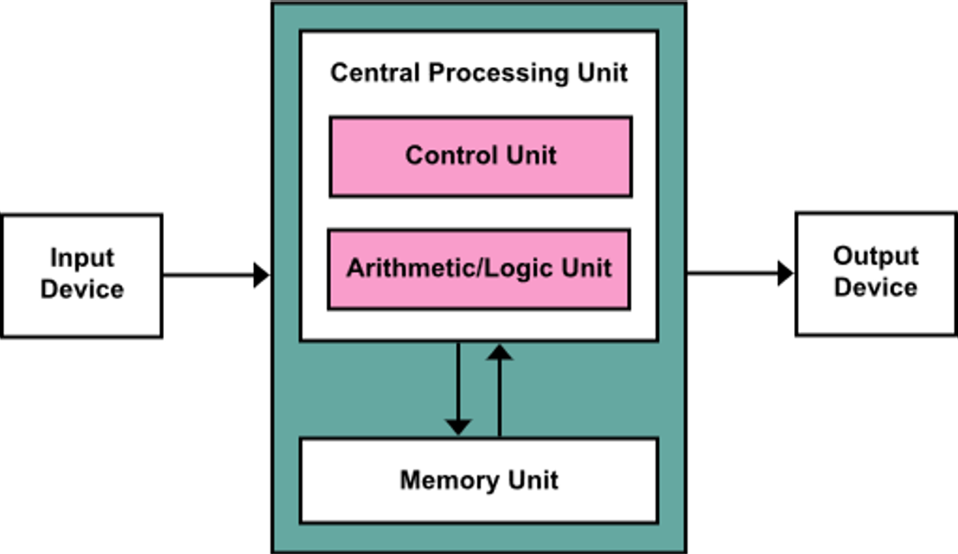
von Neumann Architecture
The von Neumann architecture is the basis for digital computers
Described in a report on the EDVAC (Electronic Discrete Variable Automatic Computer) in 1945 and identifies the common components of modern computers:
a processing unit with an arithmetic logic unit and registers
a control unit
memory storing data and instructions
secondary storage (external)
IO facilities
List of instructions which record and amend the values of variables (data) in memory as the statements are executed essentially in a sequence
State of the program i.e. the data values, moves from an initial state through changes to a final state which represents the required result
Basis of the imperative approach to solving problems:
‘First do this and next do that’

Slide 12
Imperative Approach (Procedural)
Programming Concepts
Variables and types
Statements
Assignment, I/O, expressions
Structured Programming
Spaghetti code problem
‘Go To Statement Considered Harmful’ (Edsger Dijkstra, 1968)
Stepwise Refinement (Niklaus Wirth)
start with an overall description of the solution and, at each stage, refine the solution as a more detailed sequence of statements, a choice of alternative paths, and, a block of statements to be repeated
Any problem with a logical solution only requires three ideas for organizing the solution:
sequence; selection, and, iteration

Slide 13
Imperative Approach (Procedural) (cont.)
A single High Level Language statement is essentially an abstraction of multiple machine code instructions
A facility to group statements under a single name and use the name as a statement call/execute that group of statements when they were required was desirable
concept of a procedure (routine, function) allows software to be designed as separate units
Focus of procedural approach is to break down a programming task into a collection of variables, data structures, and subroutines
Relies on procedures that operate on data, behaviour, and the data being separate
any given procedure might be called at any point during a program's execution, including by other procedures or itself
Handles complexity through top down design (functional decomposition)
start with a problem (procedure) and then systematically break the problem down into sub problems (sub procedures), until sub problems are straightforward enough to be solved by the corresponding sub procedure
Conceptually this is quite different from OO approach:
with Procedural you think about what something does and what it does it to
with OO you think about what something is and how it can be used

Slide 14
Modular Approach
A modular approach to designing a solution a problem was developed in the 60s and involves identifying separate units of concern which address part of the problem solution and are combined to create the overall solution
Ideally programming languages provide a greater facility than a procedure/function
a module which can be separately translated and executed and can be reused across multiple applications
this leads to the idea of a library of reusable code
The combination of modular & structured design and implementation ideas utilised in procedural programming became the dominant approach to software development until the late 80s when object oriented ideas came to the forefront

Slide 15
Imperative Approach (Object oriented)
Based on the concept of objects which may contain data, in the form of fields, and behaviour, in the form of methods
Complex problem domains can be modelled as the collaboration between a collection of simpler objects each with its own responsibilities and the capability to communicate with each other using messages, or method calls
Key concepts include encapsulation, composition, inheritance, polymorphism
Most OO languages (such as C#, Python) are actually class-oriented
classes define what types of objects can be created and objects are instances of those classes
the type system typically includes classes as types
behaviour/code reuse is implemented through inheritance of classes
class Car{
string manufacturer;
string model;
Car myCar = new Car(“Ford”, “Focus”);

Slide 16
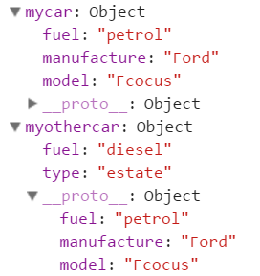
Imperative Approach (Object oriented) (cont.)
Some OO languages (notably JavaScript) are not class-oriented, but are prototype-oriented
no classes, objects are created arbitrarily
Can add new fields (or behaviour) at run time
behaviour reuse by cloning existing objects that serve as prototypes
var mycar = {
“manufacturer": “Ford",
“model": “Focus"
}
mycar.fuel = “petrol”
var myothercar = Object.create(mycar)
myothercar.fuel = “diesel”
myothercar.type = “estate”
objects visualised in debugger

Slide 17
Declarative Approach
Declarative approach to solving a problem involves a focus on results rather than processing
we are not concerned with how a result is achieved just the result
often this transfers control of how results are achieved to a processor
i.e. the processor decides how to move from input to output
Declarative programming encompasses a number of other specific programming models
Logic
a program written in a logic programming language is a set of sentences in logical form, expressing facts and rules about some problem domain
Domain Specific
a domain-specific language (DSL) is a computer language specialized to a particular application domain, usually declarative
“small languages”, focused on a particular aspect of a software system
examples include markup languages such as HTML, software build configuration languages, CSS, regular expressions
Typically rely on a general purpose language to complete task
Functional

Slide 18
Functional Approach
Functional approach involves composing the problem as a set of functions to be executed
You define carefully the input to each function, and what each function returns
There are (in principle) no changes of state (side-effects) or control flow
Equivalent example to imperative example (this is also in C# which supports functional programming to some extent)
result = mylist.Select(i => i + 1).Sum();
This takes a list, selects and applies a transformation to each element in the list (add 1) and applies a sum function to aggregate the results of applying that transformation
No variables change their values (i => i + 1 defines a transformation, not an assignment statement)
Imperative approach | Functional approach
Focus on how to perform tasks (algorithms) and how to track changes in state. | Focus on what information is desired and what transformations are required

Slide 19
What is a function?
In programming, a ‘function’ is a self contained module of code that accomplishes a specific task
Functions provide a way to make code modular
In OO programming, these belong to classes and are called methods
In mathematics, the word ‘function’ has a more specific meaning
A function is a relation, or mapping between a set of inputs and a set of permissible outputs with the property that each input is related to exactly one output
For example:
f(x) = x²
Maps any number (x) to the square of that number, e.g. f(3) = 9, f(4) = 16
For given input x you always get the same result
You don’t change x in process
Functional programming is based on the mathematical definition

Slide 20
Composition
Combination of individual units to perform a more complex task
In OO programming we compose objects to model a complex scenario, so classes are the building blocks of OO programming
In functional programming, we can compose functions rather like the way mathematical functions can be composed
Functions are the building blocks of functional programming
For example, mathematical functions f, g and h can be defined as
f(x) = x²
g(x) = x + 2
h(x) = f(g(x)) - h is a composition of f and g
So h(3) = f(g(3)) = f(3+2) = f(5) = 25 - what about (g(f(x))?
5
3 g(3) f(5) 25
output (5) from first function is input to second function

Slide 21
(Im)mutability and (no) shared state
Compare the following, more imperative, approach to the same computation
x = 3
x = x²
x = x + 2
Here, the computation is a series of steps, produces the same result as before, but:
The value of the variable x changes, so x must be mutable (can change)
The value of x is shared between the steps, both access the same variable and assume it will have the correct value for that stage of the computation - x is shared state
Harder to be sure about the result - value of x could potentially be changed by other code in between these steps executing
Functional approach favours immutability (no side effects) and no shared state
Each function does its evaluation based on the input it is given
Doesn’t care about what has happened previously
Generates new value which it outputs, doesn’t change the input

Slide 22
Side effects
Side effects are operations that change the global state of a computation.
Assignments and all input/output operations are considered side-effects
“Pure” functional programming is completely free from side effects
However, it is impossible to write any real-world applications without any side effects as you could never write anything to the user, and you could never save anything to disk
Can get most of the benefits of functional approach while still allowing some kinds of side effects, e.g
input/output that does not effect the global state of the system, such as output to the screen
assignments to local variables that only exist within the scope of the function in which they are located and cease to exist when the function returns

Slide 23
First Class Functions
The core value of functional programming is that functions should be first-class
Can be declared and invoked & can be used in every segment of the language as just another data type

Slide 24

Functional Thinking
Functional programming requires you to think about programming tasks in quite a different way from imperative programming
Not necessarily a “better” way of thinking, but provides a more efficient solution to some common problems
A functional language (or one that supports functional programming) provides you with the tools to design and implement programs based on functional thinking
Here are two important general principles to keep in mind:¹
Focus on results, not steps (be declarative, not imperative)
Offload mundane details to programming languages, focus on the unique aspects of your programming problems
1. http://nealford.com/functionalthinking.html

Slide 25
Motivating examples
Before we dive into the details, here are two simple examples of imperative and functional approaches to solving the same problem
Interested in the approach and functional thinking, not specifically in the language
Functional approach shown with both Java and Scala
Java has some support for functional techniques, particularly in Java 8
You will learn more soon about how the functional examples work and about Java’s functional features
Later you will learn about Scala’s extensive support for further functional programming techniques

Slide 26
Motivating examples - factorial
Calculate the factorial of a number, for example, the factorial of 4 is 4! = 1 * 2 * 3 * 4 = 24
IMPERATIVE (Java)
public int factorial(int n)
{
int result= 1;
for (int i=2; i<=n; i++)
{
result = result * i;
}
return result;
}
FUNCTIONAL (Java)
public int factorial(int n) { if(n==0 || n==1) return 1; return factorial(n-1) * n; }
FUNCTIONAL (Scala)
def factorial(n: Int): Int = n match { case 0 => 1 case _ => factorial(n-1) * n }
step-by-step instructions, variables i and result change to keep track of count and value after each iteration
just evaluate expressions (“focus on results…”), making use of recursion, where an expression includes a call to the function that it is inside, widely used in FP

Slide 27
Motivating examples – check for upper case
Want to check whether a string contains any upper class characters
e.g. return true for “FishAndChips”, false for “fishandchips”
IMPERATIVE (Java)
boolean nameHasUpperCase = false;
for (int i = 0; i < name.length(); ++i)
{ if (Character.isUpperCase( name.charAt(i)))
{ nameHasUpperCase = true; break; } }
FUNCTIONAL (Java 8)
boolean nameHasUpperCase =
name. chars().
anyMatch(c -> Character.isUpperCase(c));
FUNCTIONAL (Scala)
val nameHasUpperCase = name.exists(x => x.isUpper)
use method that is provided by the programming language to take care of iteration and applying the condition/rule that we specify - “offloading mundane details…”
algorithm explicitly combines iteration and selection – if statement condition is the rule we want to apply

Slide 28
Motivating examples
NOTE!
These examples show features of different programming styles, not of the languages chosen
You can write imperative style code in Scala just as you can in Java
You can use recursion in Java just as you can in Scala
A new streams API was introduced to Java in Java 8 which is illustrated in the second example (the anyMatch method)
Scala had similar features built in from the start , illustrated by the use of the exists method of a Scala string
Now move on to look at the principles that underpin functional programming styles

Slide 29
General Principles
General principles:
Focus on results, not steps (be declarative, not imperative)
Offload mundane details to programming languages, focus on the unique aspects of your programming problems
Often possible to write the same computation in imperative or functional styles
Functions map inputs to outputs, always get same output for the same input, can be composed
Functional style favours no side effects (immutability) and no shared state
Models of computation – Turing Machine and Lambda Calculus, Church-Turing thesis
Practical implementation of Lambda concepts available in Scala and recent version of Java
Recursion is commonly used to perform iterative computations in functional programming

Slide 30
Computation – a (little) bit of theory
The theory of computation deals with how efficiently problems can be solved on a model of computation, using an algorithm – asks "What are the fundamental capabilities and limitations of computers?“
A model of computation is the definition of the set of allowable operations used in computation and their respective costs – it is essentially a theoretical “computer”
Models of computation were considered long before practical computers were common, notably:
Turing Machine, a hypothetical machine devised by the mathematician Alan Turing in the 1930s – computation by performing instructions
Lambda Calculus, developed by another mathematician, Alonzo Church, also in the 1930s – computation by applying functions
Both can simulate ANY computer algorithm, no matter how complicated it is
They are equivalent – Church-Turing thesis

Slide 31
Turing Machine
“Machine” consists of an infinitely-long tape which acts like the memory in a typical real computer. The tape consists of squares that can be written with symbols
It also has a control unit that can be in one of a finite number of states
At any one time, the machine has a head which is positioned over one of the squares on the tape. With this head, the machine can perform some very basic operations:
Read the symbol on the square under the head
Edit the symbol by writing a new symbol or erasing it
Move the tape left or right by one square
Change the state of the machine
Turing reasoned that any computation that could be performed by a human involved writing down intermediate results, reading them back and carrying out actions that depend only on what has been read and the current state of things.
1
0
1
1
0
infinite tape
control unit
state: Y
Note that a Turing Machine is not a real device, it’s just a way of describing a set of allowable operations
but see www.youtube.com/watch?v=E3keLeMwfHY#t=33
for an example of a ‘real’ Turing machine

Slide 32
Turing Machine computation - example
How would a Turing machine add 1 to a number
First, how do we represent the number?
Could be binary with symbols 1 and 0 on the tape
Then, what is the algorithm?
Start from right and move to left one digit at a time (that is, move the tape to the right past the head)
If 1 change to 0
If 0 change to 1 and stop – we have result
Does this always work? Try some other examples, e.g. 01100, 01111. Why do we need to have the leading 0 when representing the number?
Subtraction is similar, though slightly more complicated
Can build up more complex computations – e.g. adding two numbers by repeatedly adding 1 to the first and subtracting 1 from the second until the second is 0
example:
01011 (decimal 11)
01010
01000
01100 (stop – now have decimal 12)

Slide 33
Lambda calculus
Lambda (λ) calculus is the theoretical foundation for functional programming, and its influence can be seen in aspects of practical functional languages
“Calculus“ sounds very mathematical, but lambda calculus is quite simple - does not have any complicated formulae or operations – but it is very abstract which can be difficult to appreciate
All it ever does is take a collection of letters or symbols (an expression) and does some substitutions
Example:
(λx.x)(y)
This contains:
Variables – x and y in this example
Parentheses ( ) - indicate that some part of an expression belongs together
The Greek letter λ – indicates that what follows is a function
The names of the variables are not important, the only thing that matters is that when two variables have the same name, they are the same. (λa.a)(b) is exactly the same expression
They are not like variables as you understand them in programming, they do not hold any information

Slide 34
Lambda expression example
head
body
application
(λx.x)(y)
Function consists of a head (λ and an expression containing bound variable(s) – just x in this example), a dot and a body - a bound variable is somewhat like a function parameter in programming
Body is an expression, can consist of variables, parentheses and other expressions
Can have an expression after the function, called an application, this is a bit like the parameter value(s) in programming (but remember there are no actual values in lambda calculus)
The whole line is an expression – an expression can be built up from other expressions, including functions
function

Slide 35
Resolving a lambda function
What does a function calculate? Nothing, really. It is just an expression, the only thing we can do with it is to resolve it
Resolution works by taking the variable mentioned in the head, and replacing all of its occurrences within the body with the application
( λx.x)(y)
= y
This function, applied to y gives y – in other words it gives you back what you started with
This is a special function called the identity function
Replace x in the body with y
Function is now resolved so remove λx

Slide 36
Lambda calculus computation - example
Let’s look at the same example as we did for the Turing machine – adding 1 to a number
First problem – we don’t have numbers in lambda calculus, just expressions with functions and (meaningless) variables
Need to represent numbers as functions – seems strange, but why not? There are many ways of representing numbers apart from the decimal system we are used to, e.g. Roman numerals
Let’s define zero as :
0 = λsz.z (remember names don’t mean anything, so this is the same as λ ab.b or λ fg.g )
And the next few natural numbers as (you’ll see why shortly):
1 = λsz.s(z) 2 = λsz.s(s(z)) 3 = λsz.s(s(s(z))) ...
So this (rather weird number) system starts with a “0” function and nests an expression s(..) round the body once more for each successive number

Slide 37
Lambda calculus computation - example
Our “add 1” computation needs to get us from one number to the next
The only mechanism we have is applying functions, so we need to define an “add 1” function that if you apply to our “0” expression and resolve will give our “1” expression, and so on
A function that works is:
λ abc.b(abc)
Applying this to our zero expression
(λ abc.b(abc)) (λ sz.z)
and resolving, gives our “1” expression λ sz.s(z) (see next slide for details of how this works)
Similarly, applying the same function to “1” gives “2”, and so on
Can add a number to another by applying the “add 1” function the required number of times
Note that if a and b are expressions, then ab is an expression. Similarly, if ab and c are expressions, abc is an expression

Slide 38
Lambda calculus computation - example
(λabc.b(abc)) (“0”)
= (λabc.b(abc)) (λ sz.z)
= λbc.b((λ sz.z) bc)
= λbc.b((λ z.z) c)
= λbc.b(c)
= λsz.s(z)
= “1”
Replace first bound variable a with expression λ sz.z (the “0” function)
This time replace first bound variable with b, the first expression in the application. However, the bound variable s is not in the body, so there is nothing to replace with b, so b “disappears”. Note that parentheses matter, make us resolve the function inside them before continuing
This time replace bound variable z with c
Function now fully resolved so remove λ
We’re done, but can choose to change variable names to emphasise that the result is the same as “1” function defined earlier

Slide 39
Lambda calculus summary
So where has this brief look at Lambda calculus got us?
We have a weird way of representing numbers (known as Church numerals) and a rather masochistic way of adding them (and there are similar functions for other operations)
The point is to show that, in principle, any computation that can be carried out in a series of steps can also be carried out by defining functions and evaluating expressions that apply them
This is the foundation of functional programming
There are variants of the lambda calculus
Pure/untyped – this is what we have looked at here
Applied – includes constant values and predefined functions
Typed – allows variable types to be specified
You can do a lot more with lambda calculus, but we’ll leave it there and get back to some practical programming (and you won’t be asked to do any lambda calculus in the exam)!
Other variants don’t extend the range of possible computations, but they make typical computations simpler, closer to a practical programming language

Slide 40
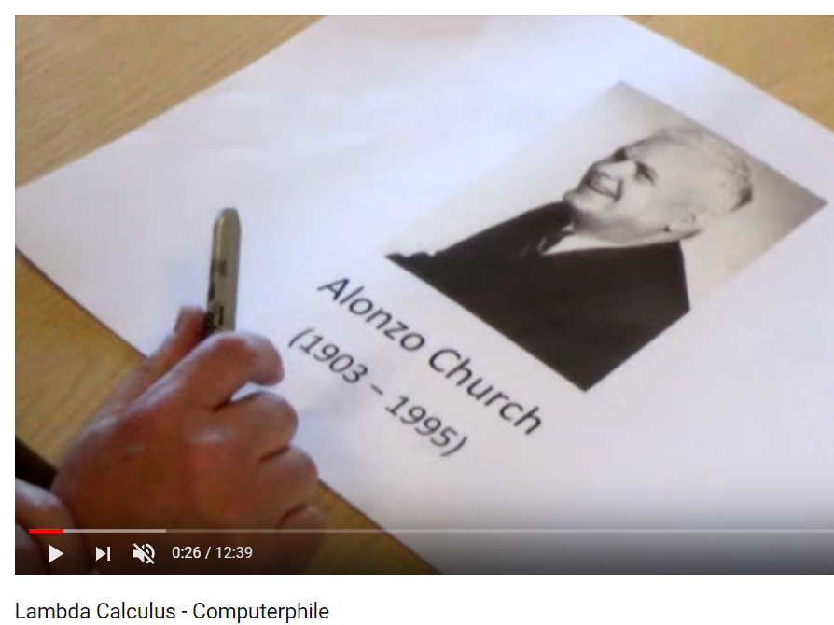
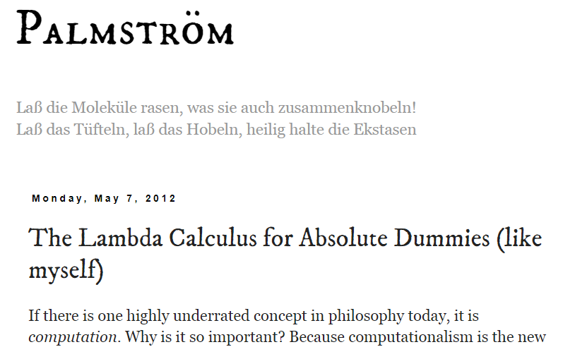
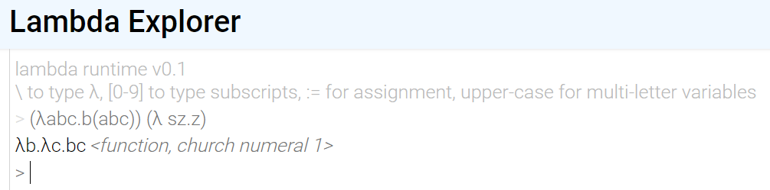
Lambda Calculus Further Exploration
https://www.youtube.com/watch?v=eis11j_iGMs
http://palmstroem.blogspot.co.uk/2012/05/lambda-calculus-for-absolute-dummies.html
http://www.lambda-explorer.net/

Slide 41
Additional reading
http://palmstroem.blogspot.co.uk/2012/05/lambda-calculus-for-absolute-dummies.html
http://www.oracle.com/technetwork/articles/java/ma14-java-se-8-streams-2177646.html

